Slide 1
Java 8 new features

Slide 2
Functional Interface with Lambda and Implementing Interfaces
Method References – Functional Interfaces
Default and static methods in interface
Stream API and Collections

Slide 3
Functional Interfaces & Lambda

Slide 4
Functional Interfaces introduced in Java 8 allow us to use a lambda expression to initiate the interface's method and avoid using lengthy codes.
Functional Interface in Java enables users to implement functional programming in Java. In functional programming, the function is an independent entity. The function can do anything a variable is capable to perform like passing a function as a parameter, a function returned by another function, etc.
A functional interface can contain only one abstract method and it can contain any number of static and default (non-abstract) methods.
Functional Interface in Java is also called Single Abstract Method (SAM) interface.

Slide 5
Ways to implement functional interfaces
Using Lambda Expression
By Implementing the Interface

Slide 6
How to implement Abstract method of functional interfaces
InterfaceName tempName = (<parameters>) -> {
// implementation of the abstract method of the Functional Interface
};
// to use this method
tempName.absName();

Slide 7
Using lambda
import java.util.*;
@FunctionalInterface
interface PersonalGreet{
String greeting(String name);
}
public class MyClass {
public static void main(String[] args){
Scanner sc = new Scanner(System.in);
System.out.println("May I please know your Name?");
String name = sc.next();
PersonalGreet hello = (String temp) -> "Hello! "+temp;
System.out.println(hello.greeting(name));
}
}

Slide 8
By Implementing the Interface
By doing so we will have to override the abstract method. Then to call the method we are supposed to create the object of our class and use the following syntax obj.AbstarctMethod().
@FunctionalInterface
interface Sample{
void absMethod();
}
public class className implements Sample{
@Override
public static void absMethod(){
// implementation
}
public static void main(String[] args){
className object = new className();
object.absMethod();
}
}

Slide 9
Example
import java.util.*;
@FunctionalInterface
interface PersonalGreet{
String greeting(String name);
}
public class MyClass implements PersonalGreet{
public static void main(String[] args){
Scanner sc = new Scanner(System.in);
System.out.println("May I please know your Name?");
String name = sc.next();
MyClass obj = new MyClass();
System.out.println(obj.greeting(name));
}
@Override
public String greeting(String name){
return "Hello! "+name;
}
}

Slide 10
Method References- Functional Interface
What is Method Reference(::) ?
we use lambda expressions to implement Functional interfaces with minimum lines of code and even to get better code readability.
Similarly, we can use Method References(::) Java 8 to implement Functional interfaces with even lesser code again than lambda expressions and this time we get the benefit of code re-usability as well,because we don’t provide implementation for functional interface.
Instead, we provide reference to already existing method(with similar argument types) to simplify the implementation of the functional interface using double colon (::) operator.
This process of providing reference to pre-existing method is called Method reference.

Slide 11
Java 8 Interface Changes – default method and static method
Prior to java 8, interface in java can only have abstract methods.
All the methods of interfaces are public & abstract by default.
Java 8 allows the interfaces to have default and static methods.
The reason we have default methods in interfaces is to allow the developers to add new methods to the interfaces without affecting the classes that implements these interfaces.

Slide 12
Why default method?
For example, if several classes such as A, B, C and D implements an interface XYZInterface then
if we add a new method to the XYZInterface, we have to change the code in all the classes(A, B, C and D) that implements this interface.
In this example we have only four classes that implements the interface which we want to change but imagine if there are hundreds of classes implementing an interface then
it would be almost impossible to change the code in all those classes.
This is why in java 8, we have a new concept “default methods”. These methods can be added to any existing interface and we do not need to implement these methods in the implementation classes mandatorily,
thus we can add these default methods to existing interfaces without breaking the code.

Slide 13
Static methods in Interfaces
In addition to declaring default methods in interfaces, Java 8 also allows us to define and implement static methods in interfaces.
Since static methods don't belong to a particular object, they're not part of the API of the classes implementing the interface; therefore, they have to be called by using the interface name preceding the method name.
If you want to provide some implementation in your interface and you don’t want this implementation to be overridden in the implementing class, then you can declare the method as static.

Slide 14
Default & static methods in interfaces
A method inside an Interface can’t be declared default & static together. Default methods can’t be static & static methods can’t be default.

Slide 15
Stream API(Java 8 Stream)

Slide 16
Java 8 Stream
A stream is a sequence of objects that supports various methods which can be pipelined to produce the desired result.
Java provides a new additional package in Java 8 called java.util.stream.
The Stream API is used to Collection of the Object.
This package consists of classes, interfaces and enum to allows functional-style operations on the elements.
Stream does not store elements.
Stream is functional in nature. Operations performed on a stream does not modify it's source. For example, filtering a Stream obtained from a collection produces a new Stream without the filtered elements, rather than removing elements from the source collection.

Slide 17
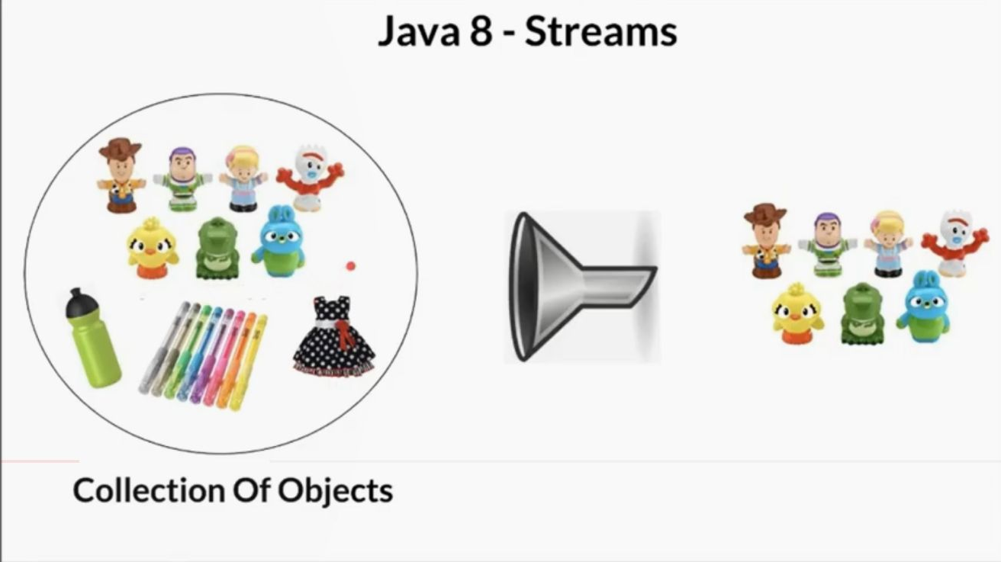
Process of Stream API

Slide 18
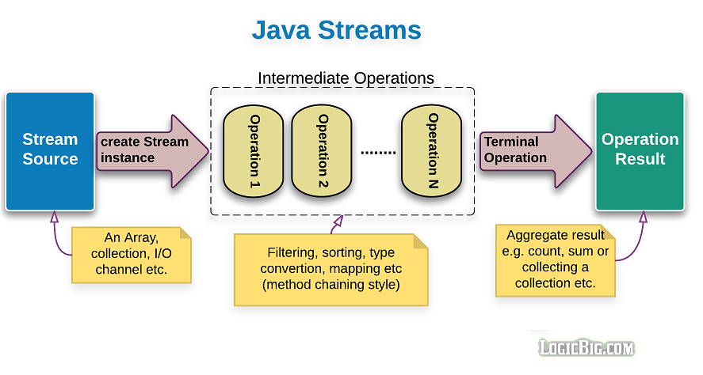
How it Works

Slide 19
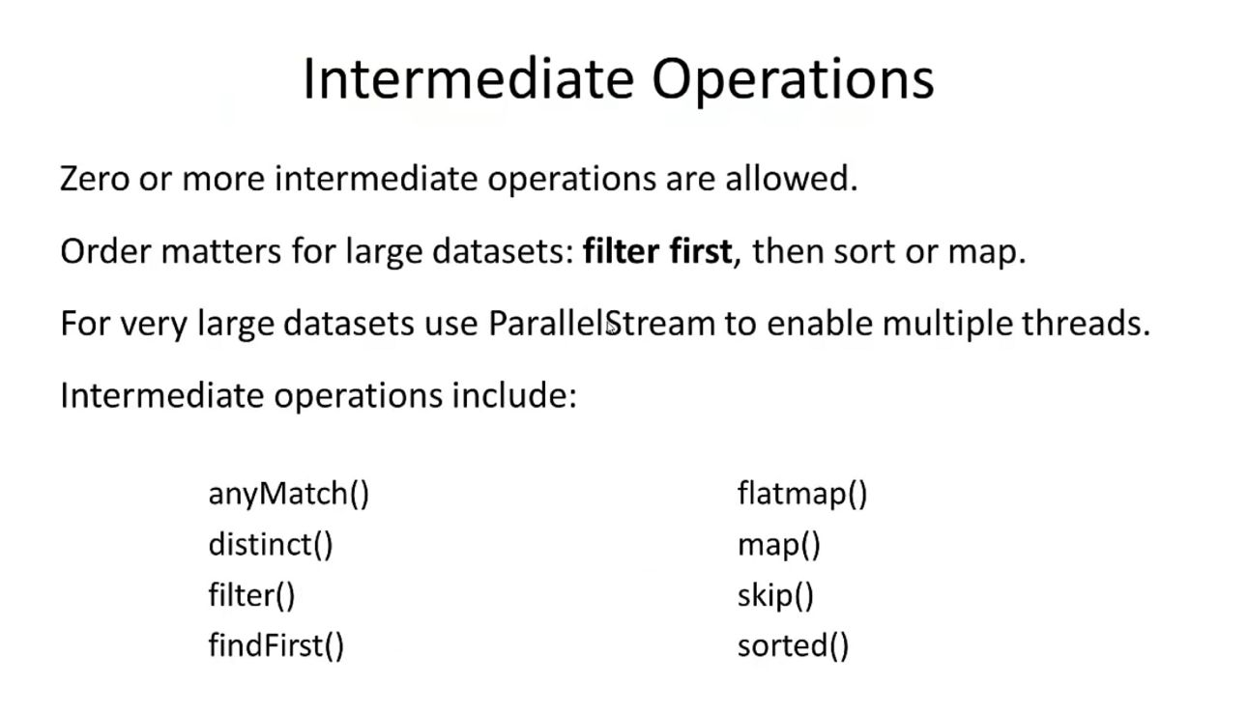

Slide 20
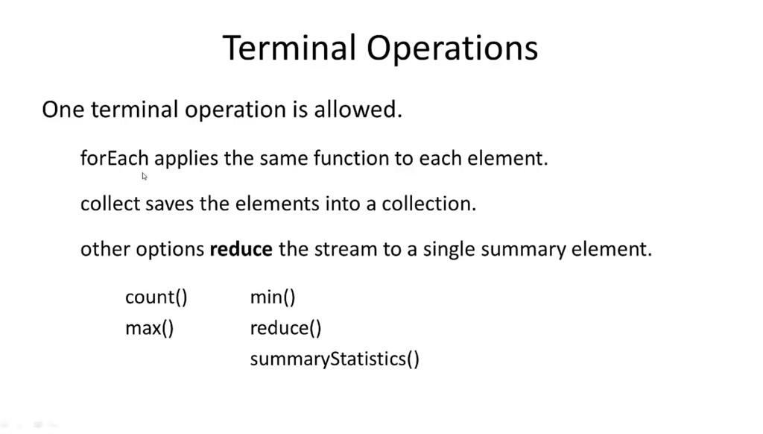

Slide 21
Sample programs
Filtering Collection without using Stream
Filtering Collection by using Stream
Java Stream Iterating Example
Filtering and Iterating Collection
Sum by using Collectors Methods
Find Max and Min Product Price
count() Method in Collection
Method Reference in stream

